Slide 1

St. Paul’s Advisory Committee Meeting
Electronic Update
August 19, 2025

Slide 2

People First ^{USI} Update
  Programmatic Updates
  Upcoming Engagement Activities

Slide 3




Education: All children and youth in
Tidewater Gardens are ready for school,
thrive in and out of school, graduate from
high school, and are prepared for college,
career and life.
Economic Mobility: All households in
Tidewater Gardens,
before and after redevelopment,
are economically independent.
Key Service Pillars and Results Statements
Health: All children and adults living in
Tidewater Gardens, before and after
redevelopment, are mentally and
physically healthy.
Housing Stability: All Tidewater
Gardens households remain stably
housed in their housing of choice.
Source: LEARN

Slide 4
Families Receiving Supportive Services
576 (94%) Households Enrolled
1595 Individuals
Children 0-18:
771 (48%)
Adults 18+
824
Avg. Household Size:
~ 3 People
Source: LEARN

Slide 5

People First Updates
Support for Residents Returning to Unity:
  USI is actively working with families who wish to return to Unity Place
  We are ensuring families have all necessary documentation and attending NRHA briefings to offer guidance and support
  Current Status: 11 families have been approved; additional families are in the application process
  Homeownership Assistance:
  People First, empowered by USI, is supporting three households currently working with lenders to achieve homeownership.
  Youth Engagement Programs:
  This summer, 26 youth (15 households) participated in various programs
  Program Highlights:
    50 youth attended summer programs, including summer school.
    118 youth are enrolled in sports, recreation, or cultural programs.
  Program Partners include (but not limited to): Southside Boys and Girls Club, Kroc Center, Norfolk Parks and Recreation, and Champions

Slide 6

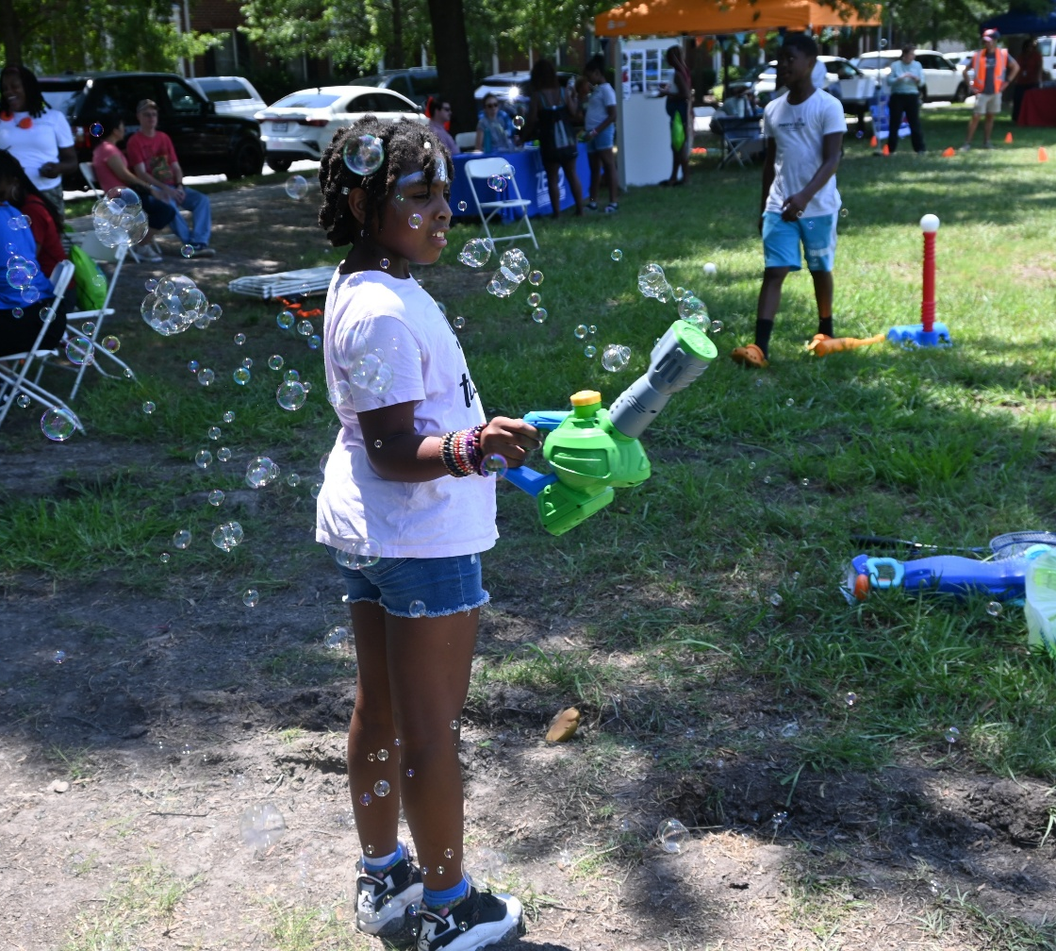
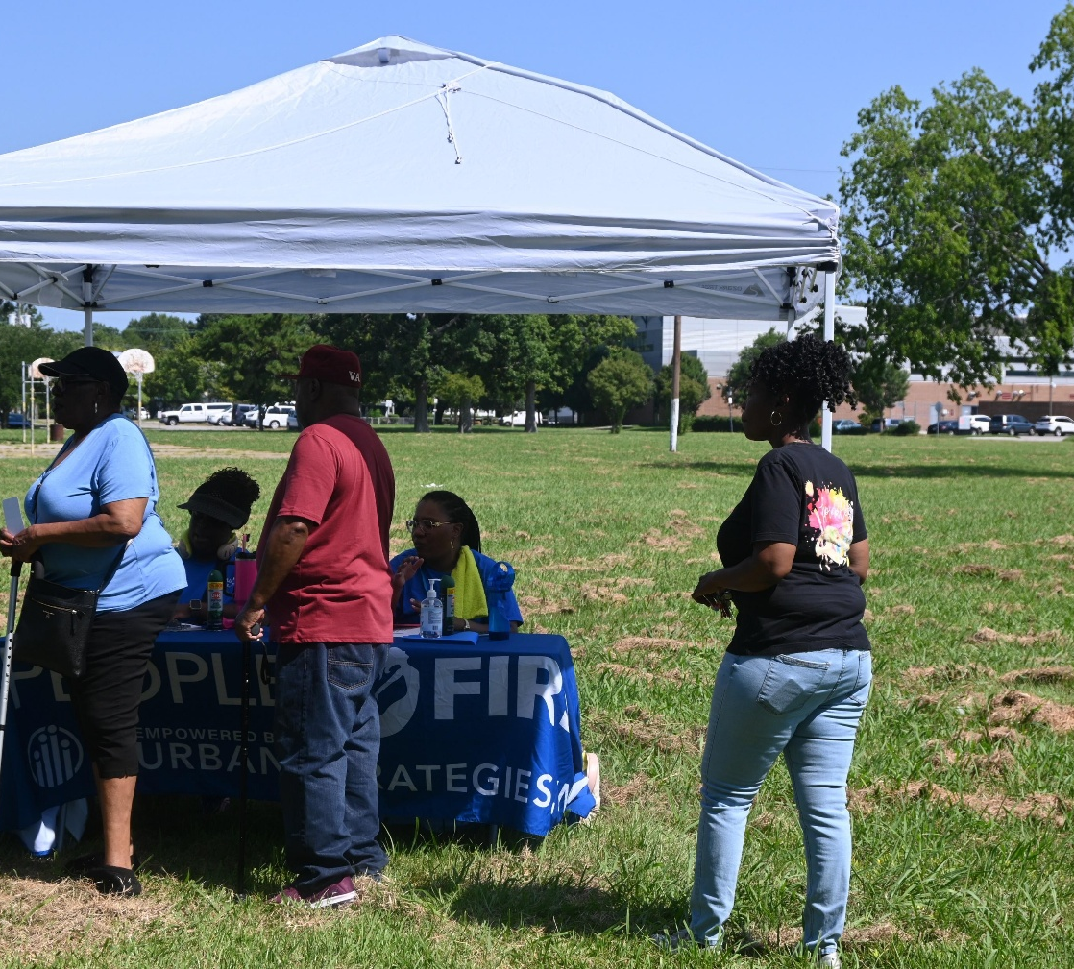
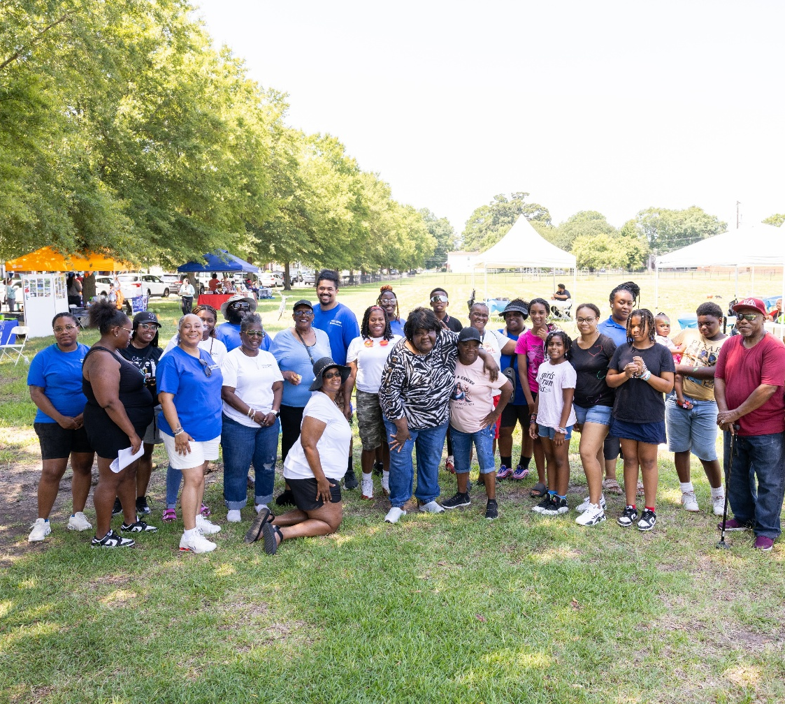
Summer Bash 2025
On July 25th, the Southeastern Cooperative Educational Program field was alive with laughter, music, and community spirit as People First hosted its annual Summer Bash! This multigenerational celebration brought together families, a powerhouse group of community partners, face painting, balloon animals, and more! The People FirstUSI Team even provided transportation so no one missed out. By the end of the day, the community left with new friendships, strengthened connections, and a few extra treats in hand.

Slide 7

Upcoming Engagement Activities
  People First, Empowered by USI- “Family Night” Chat & Chew – with sessions covering banking and goal setting for adults, as well as college preparation for students.
    September 10, 2025, 6 PM – 8 PM –– Norview Community Center –– 6380 Sewells Point Rd.
  Meet the Author Event
    September 27, 2025, 1 PM –– Jordan- Newby Library –– Broad Creek 1425 Norchester Ave.
  Partner Meeting
    September 30, 10 AM–1 PM –– Food Bank of Southeastern Virginia –– 800 Tidewater Drive.
  College Boot Camp
    Oct 27, 2025 (Time TBA) –– USI Office –– 259 Granby Street.
  Trunk & Treat
    October 30, 2025 (Time TBA) –– Food Bank of Southeastern Virginia–– 800 Tidewater Drive.
  Shanell Keene, the featured author, is a former Tidewater Gardens resident who is actively engaged in the People First program.

Slide 8


Development
  Development Update - Unity Place and Kinship at Kindred

Slide 9

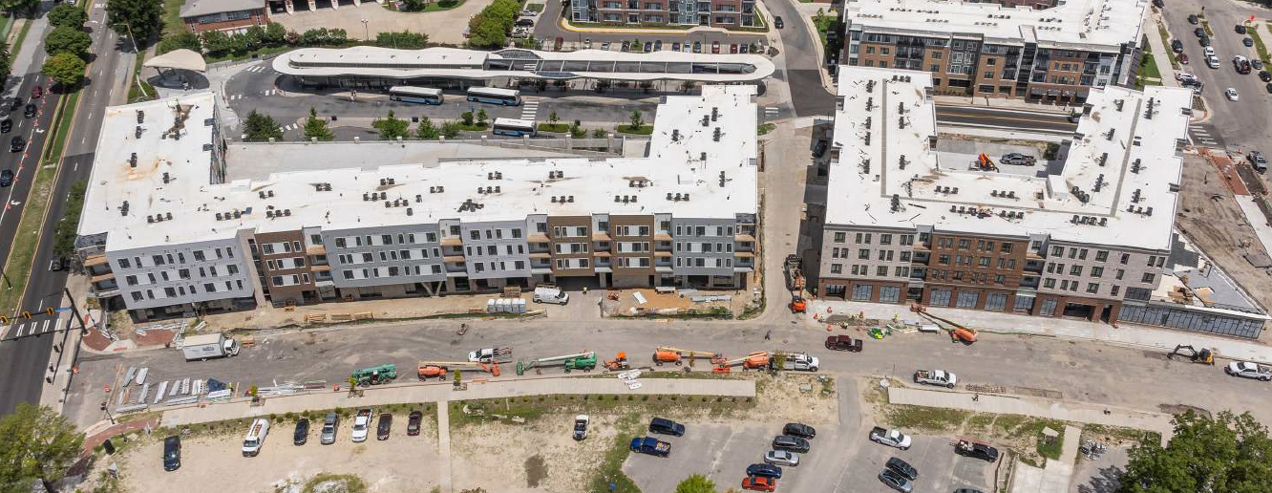



Unity Place – Block 17 and 18
Block 17
      The punch list for the residential component has been completed. The ground floor is still pending, and the final punch list is yet to be finalized.
      Sitework in progress
      Final inspections (fire alarm, elevator, etc.) in progress
      Building operational (elevator, MEP start-up, power, sprinkler)
      The Temporary Certificate of Occupancy (TCO) is projected to be issued by August 2025
      Block 18
Water & power turned on
Elevator installation in progress
Metal panel installation in progress
Finishes (paint, flooring) in progress
TCO ) is projected to be issued by October 2025

Slide 10

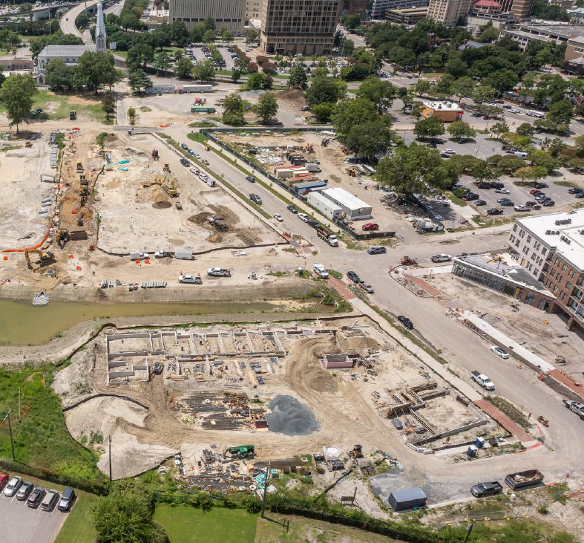

Kinship at Kindred– Blocks 9, 10, 16
Block 16
      Foundations in progress
      Block 9
      Underground utilities complete except fire sprinkler lines
      Rigid inclusions completed
      Block 10
      Rigid inclusions completed
      Underground utilities in progress

Slide 11
Economic Inclusion Efforts
  Unity Place – Block 17 and 18
  Kinship at Kindred– Blocks 9, 10, 16

Slide 12
Progress Toward Goals: Blocks 17 and 18
Project nearing completion
General Contractor: Breeden
Subcontractor | SWAM Certification # | Scope | Total subcontract amount: MBE (12.00%) | Total subcontract amount: WBE (13.30%) | Total subcontract amount: Combined (25.30%)
New Media Systems | 5606 | Aerial | $2,121.50
Colonial Construction Materials | 663589 | Silt Fencing |  | $30,543.90
Jaswal Corp | 726701 | Electrical | $4,324,300.20
Trinity Construction Services | 653456 | Site Work | $3,388,259.78
84 Lumber | 686367 | Lumber |  | $1,005,552.33
Brick Solution Inc | 662653 | Masonry | $2,889,002.93
Venemex LLC | 814061 | Drywall | $1,881,874.00
Barrier Cable Systems Inc | 719255 | Barrier Cables |  | $29,000.00
Zuleta Sheet Metal Inc | 831557 | HVAC | $2,429,766.34
Staff Zone | NWBOC RCW22438 | Temp Labor |  | $37,485.35
Blue Sky Contracting | 827123 | Painting | $616,000.00
Clearly Clean | 829064 | Final Clean |  | $120,531.99
Totals: |  |  | $15,531,324.75 | $1,223,113.57 | $16,754,438.32
Total Contract Amount (Trades): $44,083,314.06
Percentage of Total Contract Amount (Trades only) |  |  | 35.23% | 2.77% | 38.01%

Slide 13
Progress Toward Goals: Blocks 9, 10, 16
Project in progress
General Contractor: Breeden
Subcontractor | SWAM Certification # | Scope | Total subcontract amount: MBE (12.00%) | Total subcontract amount: WBE (13.30%) | Total subcontract amount: Combined (25.30%)
New Media Systems | 5606 | Aerial Photography | $6,050.00
Trinity Construction Services | 653456 | Site Work | $6,409,515.00
84 Lumber | 686367 | Lumber |  | $1,795,883.64
Brick Solution Inc | 662653 | Masonry | $3,171,000.00
Triad Mechanical | 712159 | HVAC |  | $2,603,233.00
Venemex LLC | 814061 | Drywall | $3,017,000.00
Venemex LLC | 814061 | Temp Labor | $35,000
Colonial Construction | 663589 | Silt Fence | $34,516.99
RMT | 674176 | Site Management |  | $496,856.64
Totals: |  |  | $12,673,081.99 | $4,895,973.28 | $17,569,055.27
Total Contract Amount (Trades): $59,153,123.00
Percentage of Total Contract Amount (Trades only) |  |  | 21.42% | 8.28% | 29.70%

Slide 14

NRHA Redevelopment – Young Terrace and Calvert Square Master Planning
  Progress Update

Slide 15

TENTATIVE MASTER PLAN SCHEDULE
Issue RFP Master Developer January 31
St. Paul’s Advisory Committee Monthly
Stakeholder-Calvert TMC February 26
Stakeholder-Young TMC February 27
Resident Forum March 1
Stakeholder Interviews March - April (TBD)
Additional Calvert Square Engagement (Feb - May) Monthly
Additional Young Terrace Engagement (Feb – May) Monthly
Stakeholder-Calvert Residents March 26
Stakeholder-Young Residents March 27
Stakeholder-Calvert Residents April 30
Stakeholder-Young Residents May 1
Developer Public Presentation June 4
Developer 1 Interview June 5
Developer 2 Interview June 11
Developer 3 Interview June 18
Selection Committee Site Visit – (Optional) June 23 -27
Master Developer Selected Jul3
4 Day Workshop (Charrette) July 14 - 17
Community Meeting Draft Plan Fall 2025 (TBD)
Master Plan Final Fall 2025
HUD Section 18 Submittal March 2026
First Off-site LIHTC Submittal March 2026
Yellow – Where we are today

Slide 16
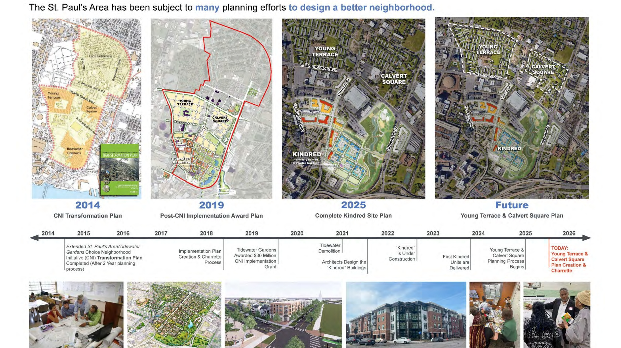

Slide 17
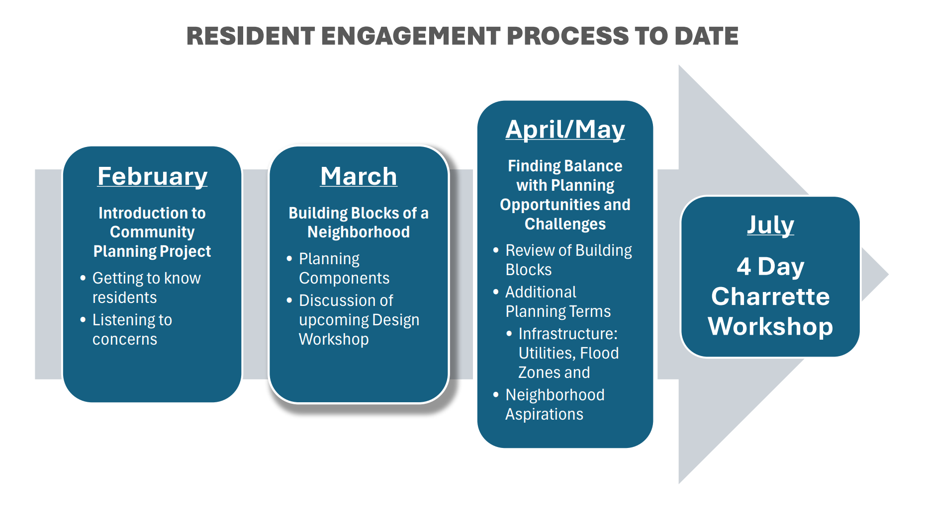

Slide 18
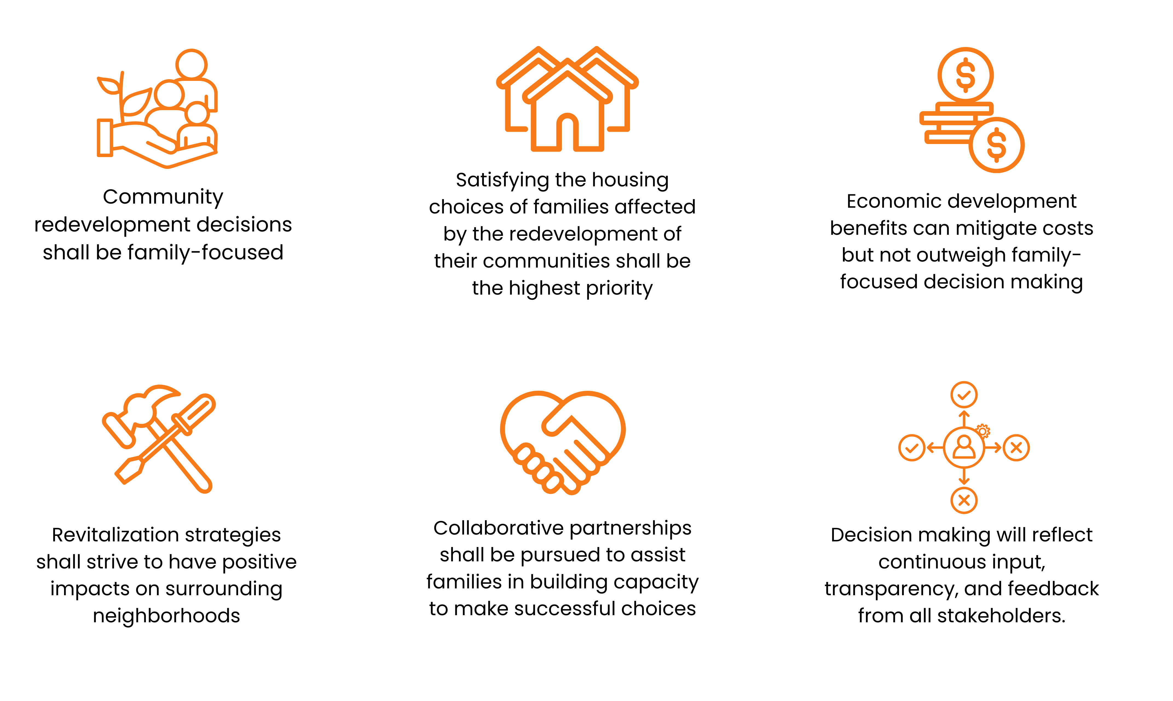
NRHA Restores and Reimagines with Community
NRHA utilizes the 6 Guiding Principles in all our redevelopment of Public Housing

Slide 19
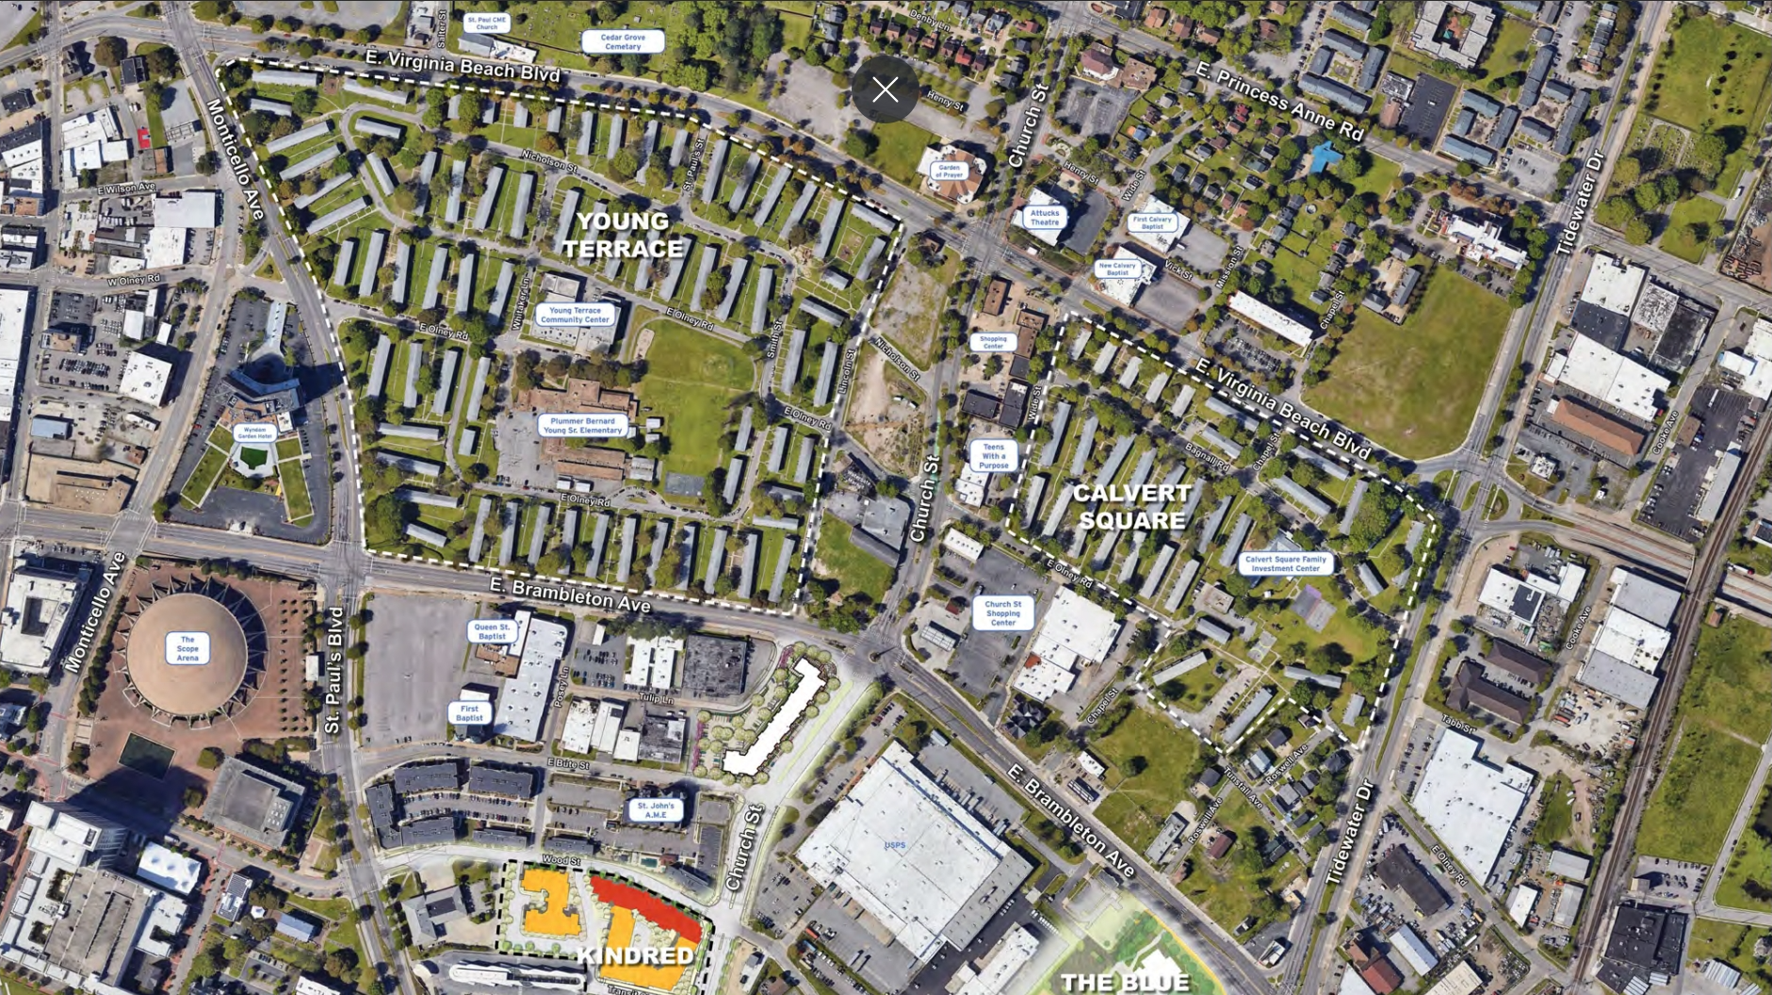

Slide 20
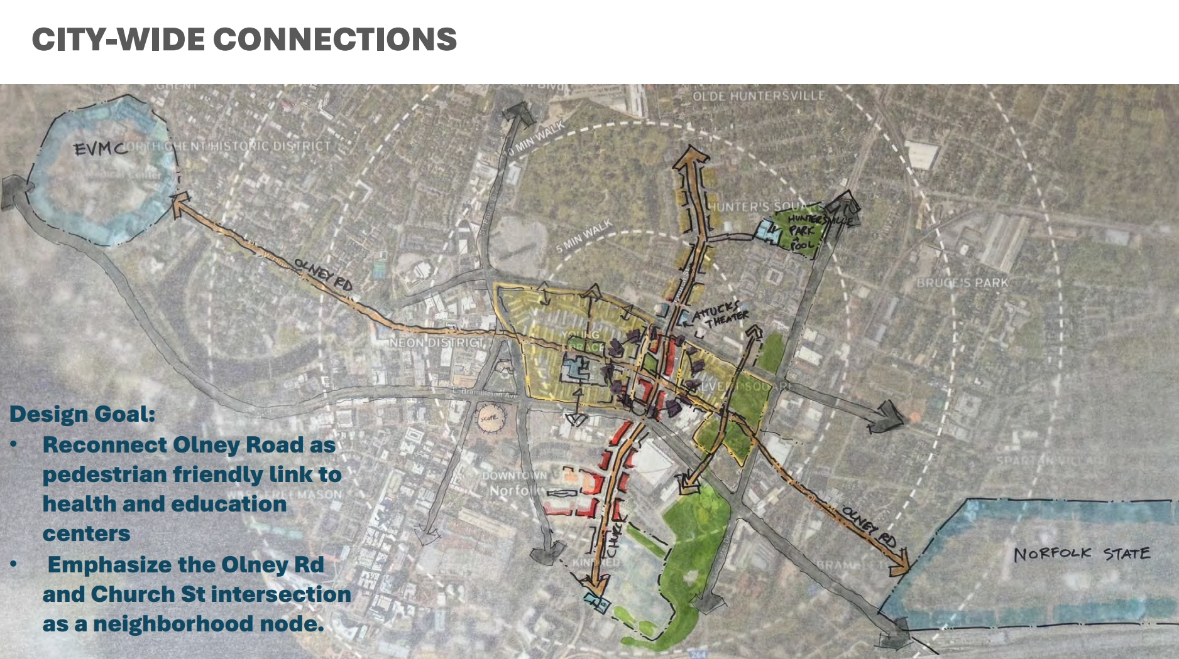
DRAFT
DRAFT

Slide 21
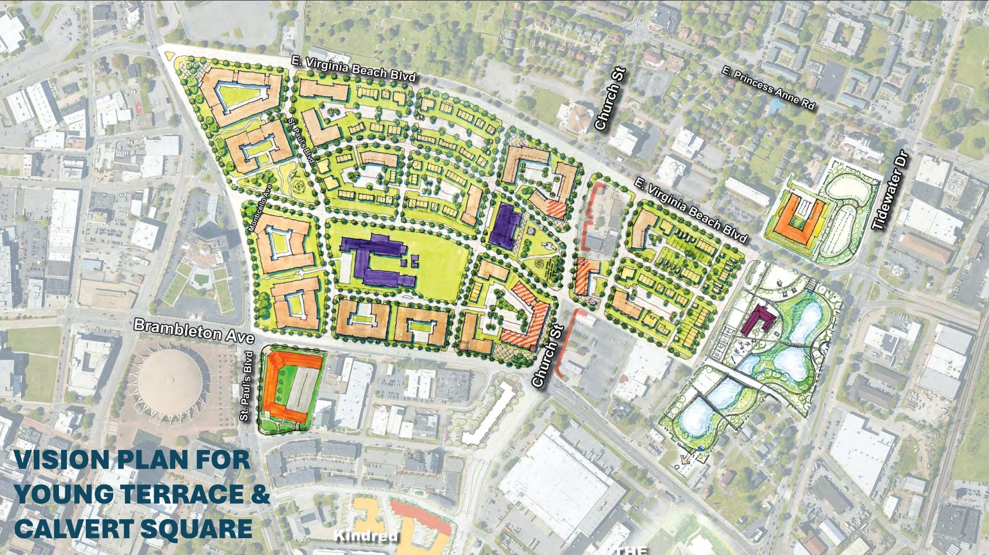
DRAFT
DRAFT
CITY OF NORFOLK PARCELS

Slide 22

Young and Calvert Master Planning
Next Steps:
NRHA, Gilbane Development, and Torti Gallas will present a comprehensive update to the St. Paul’s Advisory Committee on September 16, 2025, highlighting the refined Master Plan and key outcomes from the public charrette."

Slide 23
City Demolitions Update
  1045 E. Brambleton Ave Demolition
  1139 E. Charlotte St Demolition

Slide 24

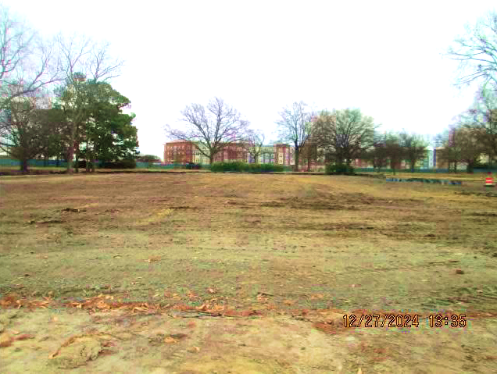
1045 E. Brambleton Ave Demolition
Demolition at 1045 E. Brambleton Ave, formerly Tidewater Park Elementary School, was completed in December 2024 by CEPHAS NeXt, Inc., a SWaM certified business.
Per Ordinance No. 49,247, the site is provided as the Option to Purchase Real Estate by and between the City of Norfolk and Hunton Y until 2033 for the construction and operation of a childcare and community enrichment facility.

Slide 25
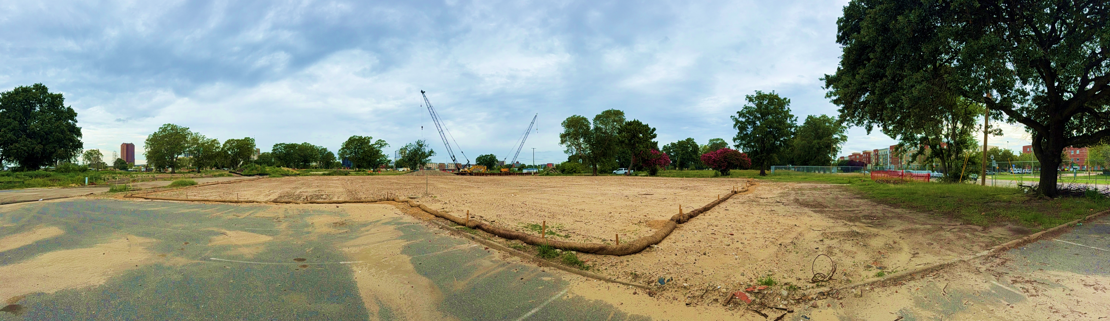
1139 E. Charlotte Street Demolition
Demolition at 1139 E. Charlotte Street, formerly William A. Hunton YMCA, site was completed in July 2025.
  Building demolition completed by CEPHAS NeXt Inc, a SWaM certified business
  Piles cutting and slab removal completed by Quality Contracting, Inc., a SWaM certified business

Slide 26
Reminders and Announcements
Available Online:
  Please like and follow our Facebook page at facebook.com/St.PaulsNFK
  Presentations, meeting minutes from previous sessions, and the latest St. Paul’s monthly newsletter are available at www.stpaulsdistrict.org
Next “In-Person” Meeting:
  September 16, 2025

